Slide 1
Multimedia Information Retrieval for Biomedical Applications
Linda Shapiro, Jim Brinkley, Dan Suciu
Indriyati Atmosukarto, Rosalia Tungaraza,
Katarzyna Wilamowska, Lynn Yang,
Sara Rolfe, Joshua Franklin

Slide 2
Motivation
Biomedical researchers work with many different types of image and signal data.
Classification is only one objective.
When studying diseases and genetic disorders, they would like to quantify the amount of presence of a condition.
This leads to the need for similarity measures.

Slide 3
Original Motivating Applications
University of Washington Eye Laboratory
  study on cataracts of the eye using slit-lens images of mouse eyes (2D Images)
Pediatric Imaging Research Laboratory of Children's Hospital and Regional Medical Center in Seattle
  study on craniofacial disorders in children (3D skulls and 2D slices)
Departments of Surgery and Psychology at the University of Washington
  study of language sites in the brain (4D fMRI and 1D SUR)

Slide 4
Objective
Develop unified methodology for organization and retrieval of biomedical data from scientific experiments
  similarity-based retrieval methodology of CBIR systems
  efficiency of relational database systems.
Provide efficient and effective retrieval of multimedia data for biomedical applications

Slide 5
Methodology
Queries are phrased through UI
  Similarity-based searches
  Standard SQL query
Image indexing techniques to rapidly return data results similar to those provided in the query in order of similarity.
Combine results from similarity relations and standard relations to efficiently answer the query.
Notes:
Queries are phrased through the user interface that allows both standard database constraints and similarity-based retrieval predicates
Queries are translated into 2 parts:
1) Similarity based searches for data that match provided query data and return results in order of similarity in the form of similarity relations
2) Standard SQL query that uses both the standard relations containing meta data and the probabilistic relations to answer the original query

Slide 6
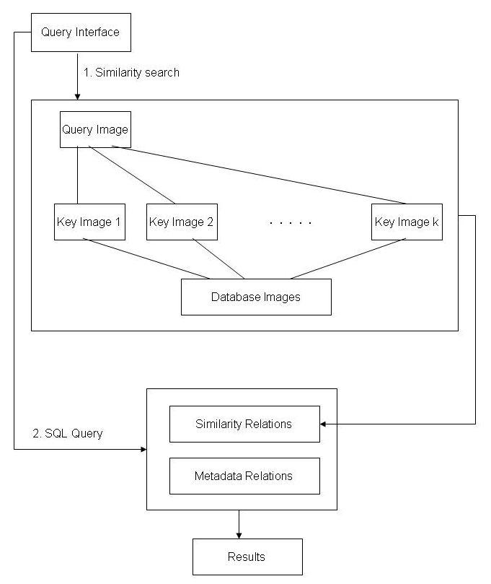
System Framework

Slide 7
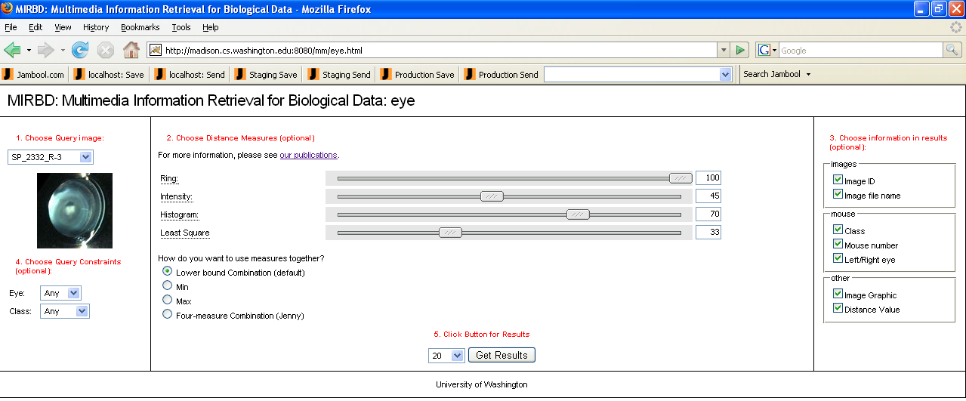
First Prototype System
Web accessible GUI using dynamic HTML and JSP
MATLAB background process
Each application has an associated Postgres database
Notes:
User selects a database
User selects a query image and is able to add constraints on the metadata
User chooses one or more similarity measures for that particular data type and can assign different weights to each of the selected similarity measures
User chooses a way to combine the results of the similarity measures
User selects fields to be returned by the query
User clicks on search to retrieve results
Ways to combine similarity measures
Indexing methodology uses triangle inequality

Slide 8
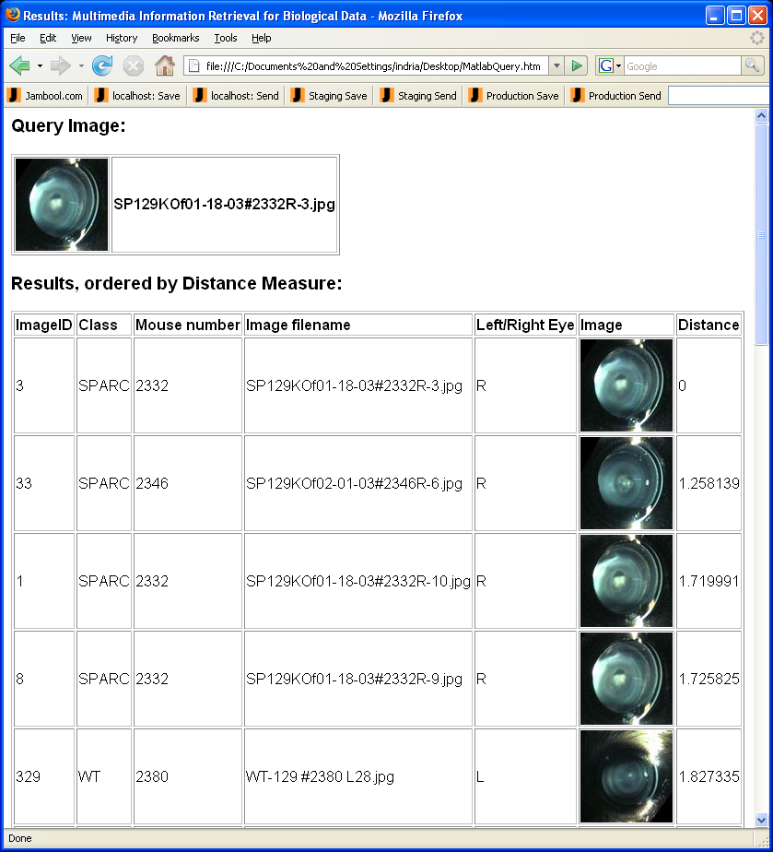
Sample Retrievals

Slide 9
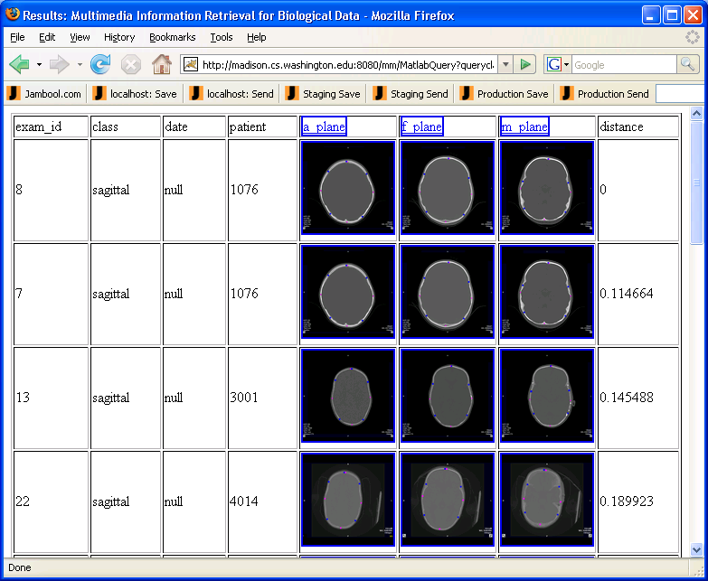

Slide 10
Current Work on New Biomedical Applications
Plagiocephaly (flat head) syndrome – Indri
Velocardiofacial Syndrome - Kasia
fMRI Analysis - Rosalia

Slide 11
1. Plagiocephaly (Flat Head) Syndrome
Problem: Skulls of babies who lie on their backs can become flat in places.
Motivation:
  Current assessment techniques are very subjective and not repetitive
  Clinical experts opinion classify degree of severity into discrete score ranges
  Continuous score allows investigation of other issues such as effectiveness of intervention, reproducible treatment measures, cognitive outcome
Objective
  Define shape severity score for flat skulls

Slide 12
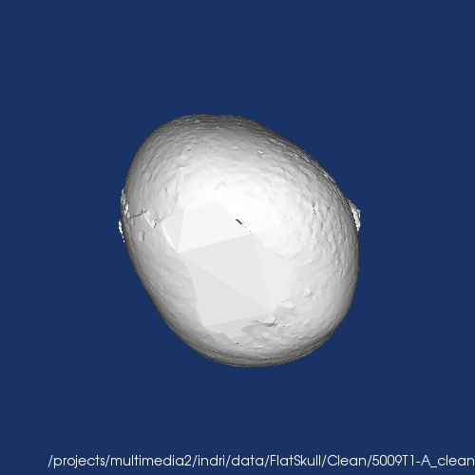
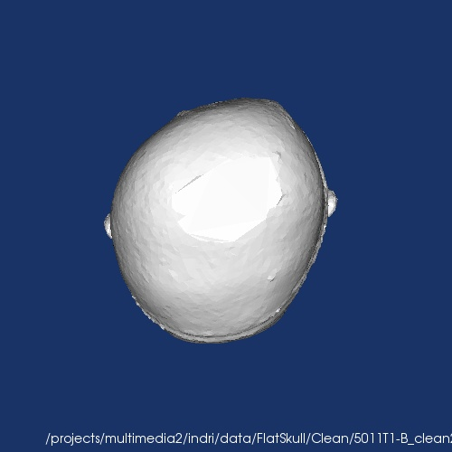
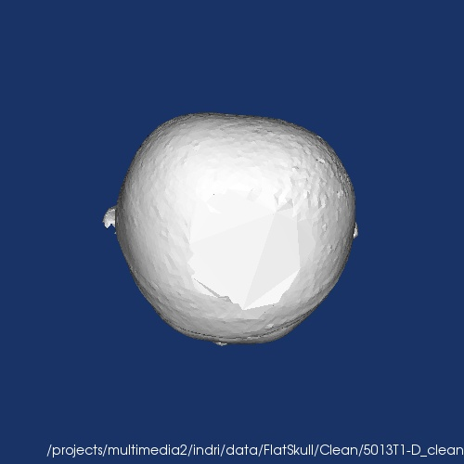
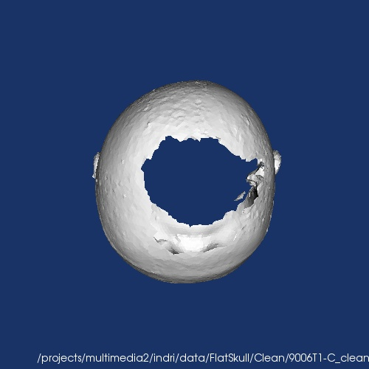
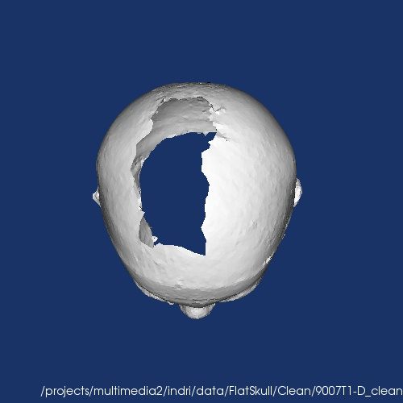
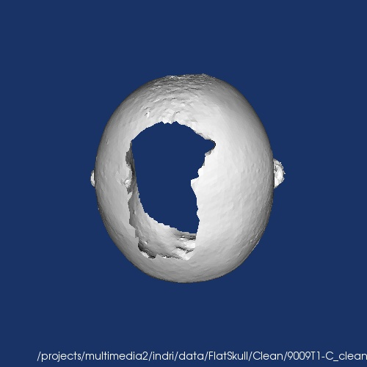
Plagiocephaly Syndrome
CASES
CONTROL

Slide 13
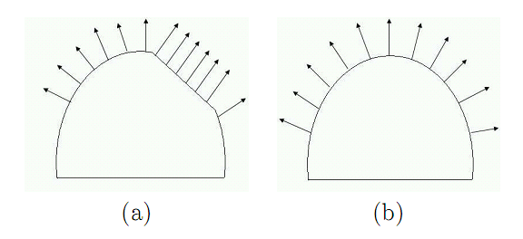
3D Shape Descriptor
Use surface normal vector
Surface normal vector of points on a flat region will all point in the same direction
Using histogram, flat areas will correspond to high bin count

Slide 14
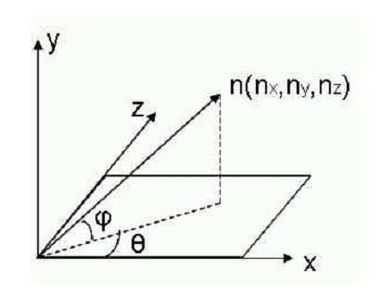
3D Shape Descriptor
Calculate azimuth and elevation of each surface normal vector
Create 2D histogram with 8x8bins

Slide 15
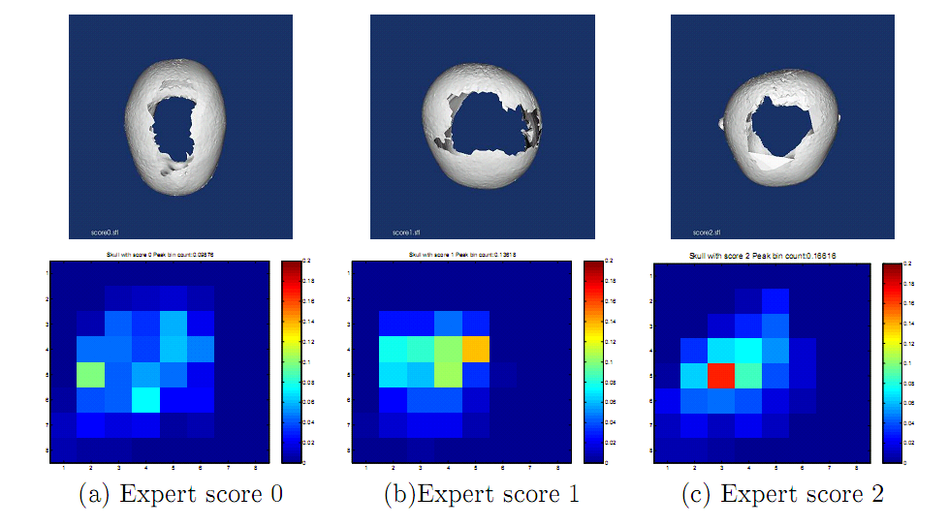
3D Shape Descriptor

Slide 16
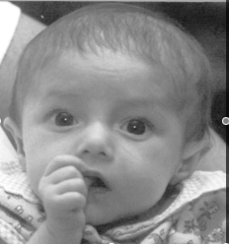
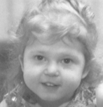
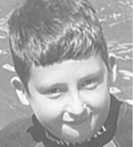
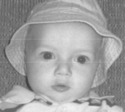
2. Velocardiofacial Syndrome
Problem: Subtle phenotype. Need experts (or genetics blood tests) to differentiate between affected and unaffected individuals.
Motivation:
  Common genetic defect and few clinical experts, yet early diagnosis can be critical to survival
  Current assessment techniques are time consuming and error prone
  Features “wash out” in older individuals
Objective
  Define spectrum of craniofacial features for affected population
Examples of affected individuals
Notes:
All photographs are affected individuals.

Slide 17
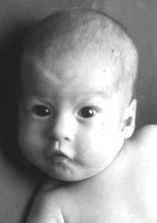
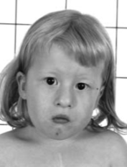
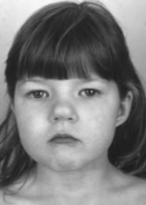
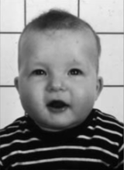
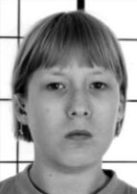
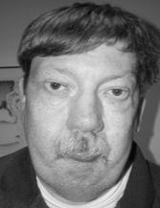
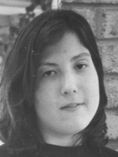
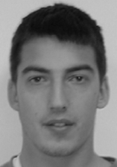
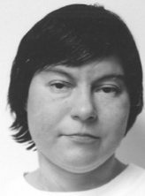
22q11.2 deletion syndrome affected individuals

Slide 18
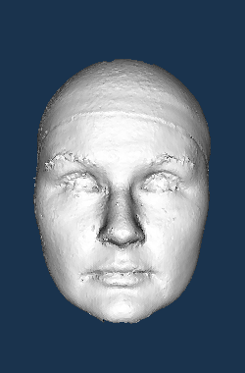
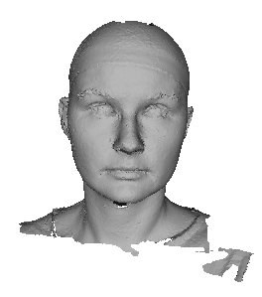
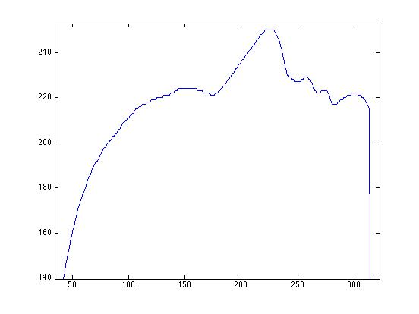
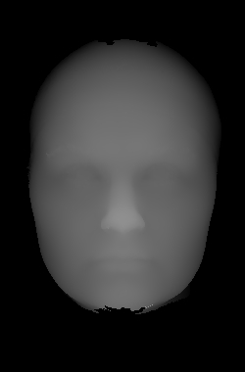
Data Types
3D snapshot
2.5D depth map
curved lines

Slide 19
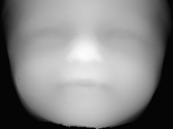
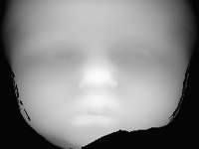
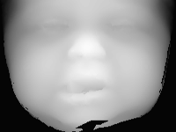
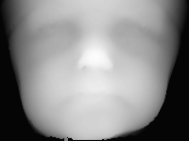
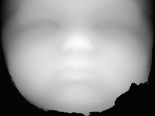
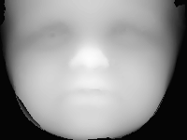
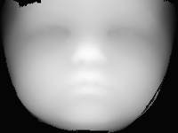
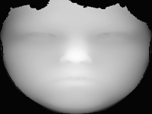
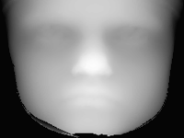
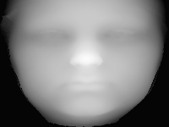
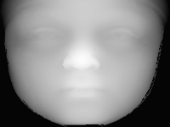
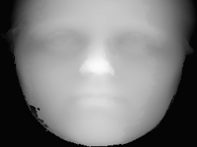
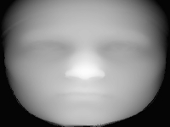
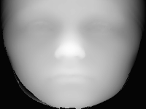
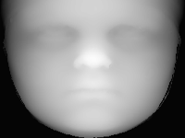
2.5D view

Slide 20
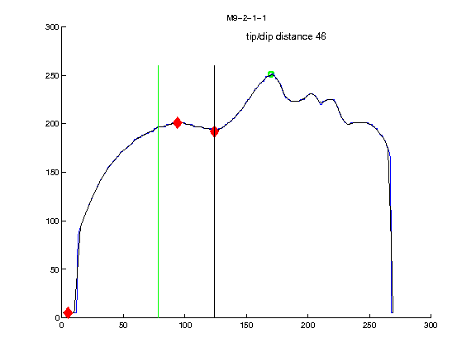
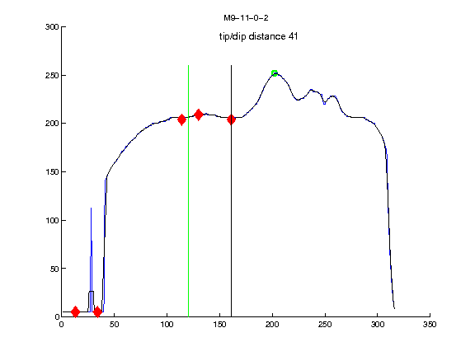
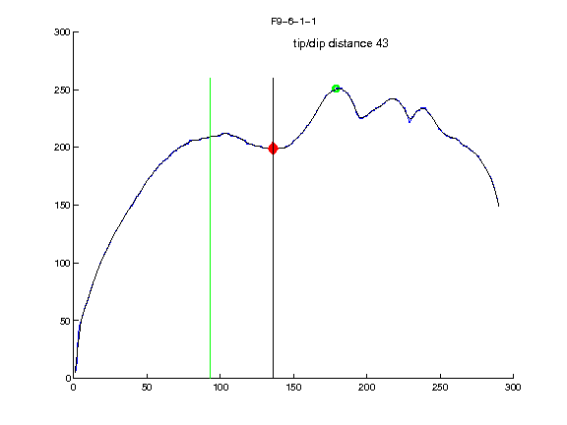
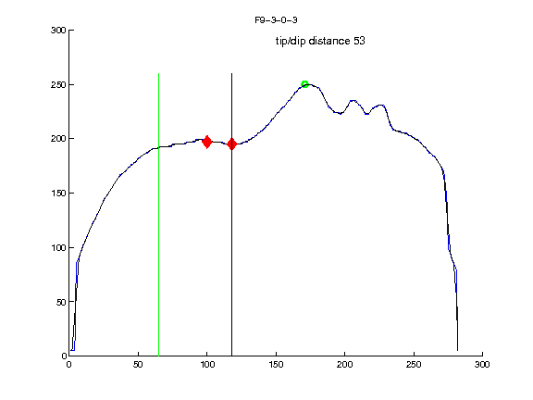
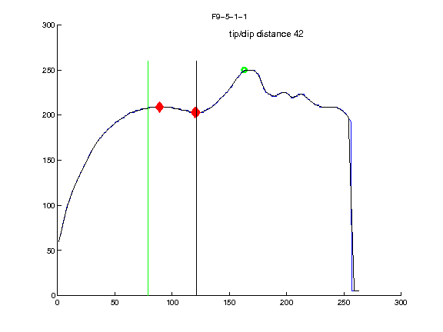

Profile 1line
unaffected
affected
Notes:
These are 9 year olds, but you can still see the bumps in the forehead of the affected.

Slide 21
Results for W86 data set represented with different data types classified using Naive Bayes
Data Set | 3D snapshot | 3D snapshot cutoff at ear | 2.5D | 5 vertical lines
F-measure | 0.71 | 0.68 | 0.72 | 0.78
Precision | 0.88 | 0.82 | 0.80 | 0.88
Recall | 0.63 | 0.62 | 0.69 | 0.73
Accuracy | 76.13% | 73.99% | 75.46% | 81.72%

Slide 22

Anthropometric survey used to provide expert ground truth for facial features of individuals in W86 data set
Notes:
W86 = 43 affected, 43 unaffected all European descent.

Slide 23
3. Similarity Retrieval for fMRI data
Problem: there is a need for tools that can identify and retrieve fMRI data with similar activation patterns from a database with fMRI images.
Motivation:
  help researchers discover hidden similarities among superficially different studies,
  identify similarities between datasets with a not-well-defined stimulus e.g. subject is watching a movie clip,
  help doctors diagnose brain disorders, by looking at the clinical history of persons with similar fMRI patterns,
  help researchers find similar studies and related research work,
  help researchers discover similarities in the brain activity, when the cognitive tasks do not seem to be related, based on psychological reasoning alone [1]
Objective: retrieve fMRI statistical maps that are similar to a given query statistical map.
Notes:
[1] Bai, Bing. Feature extraction and matching in content-based retrieval of fMRI images. Ph.D thesis. Rutgers (2007).

Slide 24
Feature Extraction
For each fMRI image in database
  Threshold it to retain the top 1% activated voxels
  Identify the total number of clusters that the image can be divided into
  Use k-means to cluster the image into those number of clusters
  Perform connected component analysis to create spatially connected regions
  Use the following properties of each region to define a feature vector:
    Cluster centroid
    Cluster area
    Average voxel activation value
    Variance of voxel activation value
    Average distance to cluster centroid
    Variance of distance to cluster centroid

Slide 25
Best match from subject i to subject j
Global Score
Subject i
subject j
Score_i = sum ( min distances from subject i to subject j ) / total regions in i
Score_j = sum ( min distances from subject j to subject i ) / total regions in j
Global Score = ( Score_i + Score_j ) / 2

Slide 26

Query fMRI
Voxel activation value
Query name: healthyAODmean_con ( the mean contrast map from the healthy subjects who performed the Auditory Oddball Experiment (AOD))
Feature units used: cluster centroid + cluster area
Feature to feature distance measure: euclidean
Subject to subject distance measure: global
Database queried: all healthy subjects from AOD and Sternberg experiment (total = 30 subjects)
Thresholding: top 1% activated voxels
healthyAODmean_con

Slide 27


Top two matches
query
healthyAOD_13
healthyAOD_9

Slide 28


Bottom two matches
query
healthyAOD_12
healthySternberg_7

Slide 29
New Multimodality System - Lynn
Extend the system to allow multiple similarity retrieval over multiple modality and multiple constraints
Three similarity measure combination levels:
  Single instance and single data modality
  Multiple instances of same modality
  Different data modalities
Results combined in a probabilistic framework to produce final answer to query

Slide 30

GUI Design
Main Screen After Patient Selection

Slide 31

GUI Design
Screen for Selecting Feature Weights after Preview

Slide 32

GUI Design
Screen for Setting Modality Weights after Preview

Slide 33

GUI Design
Sample Retrieval

